Slide 1
CHRONIC KIDNEY DISEASE DETECTION GROUP-08
PRESENTED BY
2004173 - TANNU PRIYA
2004190 - KAUSTUBH
2004221 - CHANDRAGUPT VAIBHAV
2004225 - JYOTI RADITYA

Slide 2
Contents
01
02
03
Problem Statement
Introduction
Literature Review
04
05
06
Methodologies
Output
Conclusion

Slide 3
Problem Statement
Chronic kidney disease includes conditions that damage our kidneys and decrease their ability to keep us healthy by filtering wastes from our blood. If kidney disease worsens, wastes can build to high levels in your blood and make you feel sick. We may develop complications like:
High Blood Pressure
Anaemia (Low Blood Count)
Weak Bones
Poor Nutritional Health
Nerve Damage

Slide 4
INTRODUCTION
The project aims to develop an accurate and fast prediction model for chronic kidney disease (CKD) using machine learning techniques. The model will focus on reducing the number of attributes required for prediction while maintaining high accuracy. The goal is to aid in early detection and management of CKD, potentially improving patient outcomes and reducing the burden on healthcare systems.

Slide 5
Literature Review
Researcher | Year | Classifier | Accuracy | Remarks
K.R. Lakshmi | 2014 | ANN | 93.8521% | Performed better than Decision Tree and Logical regression classifiers.
Naganna Chetty | 2015 | Naive Bayes, SMO, IBK | 99%, 98.25%, 100% | Attribute Reduction using Wrapper Method.
S.Vijayarani | 2015 | SVM | 76.32% | 584 instances and six attributes.
L. Jerlin Rubini | 2015 | Multilayer Preceptor | 99.75% | Performed better than radial basis function network, logistic regression.
Uma N Dulhare | 2016 | Naive Bayes | 97.5% | Attribute Reduction using OneR.
Huseyin Polat | 2017 | SVM | 98.5% | Attribute Reduction
Wala A. | 2017 | Decision Tree | 99% | Missing Values are replaced with mean.

Slide 6
Methodology & Discussion
Performing Data-Preprocessing and Prepare your data for analysis & Modelling Purpose as well.
Import some libraries
Read data
Rename Column name
Knowing data type
Converting the object data type to numeric
Differentiating between Categorical column & numerical column
Finding dirtiness in data (or Unique Categories)
Replace all misclassified to correct data
Print data

Slide 7

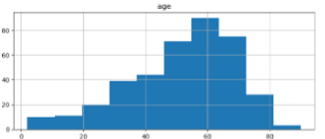
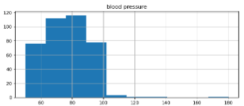
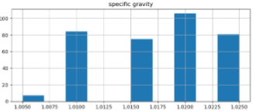
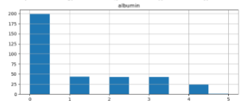
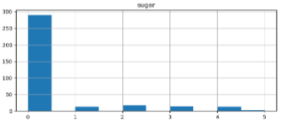
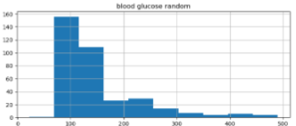
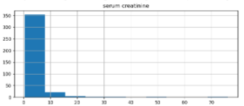
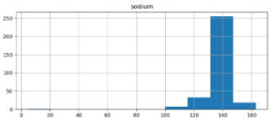
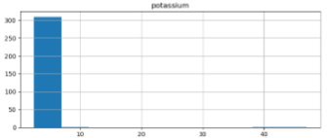
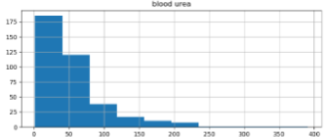
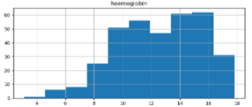
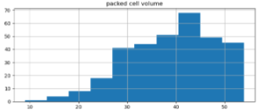
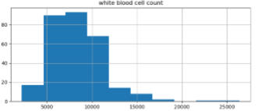
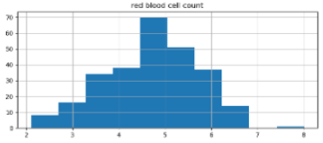
2. Analysing distribution of each & every numerical column.
Distribution of Numeric column in form of subplot
Data Inconsistency and not regular

Slide 8
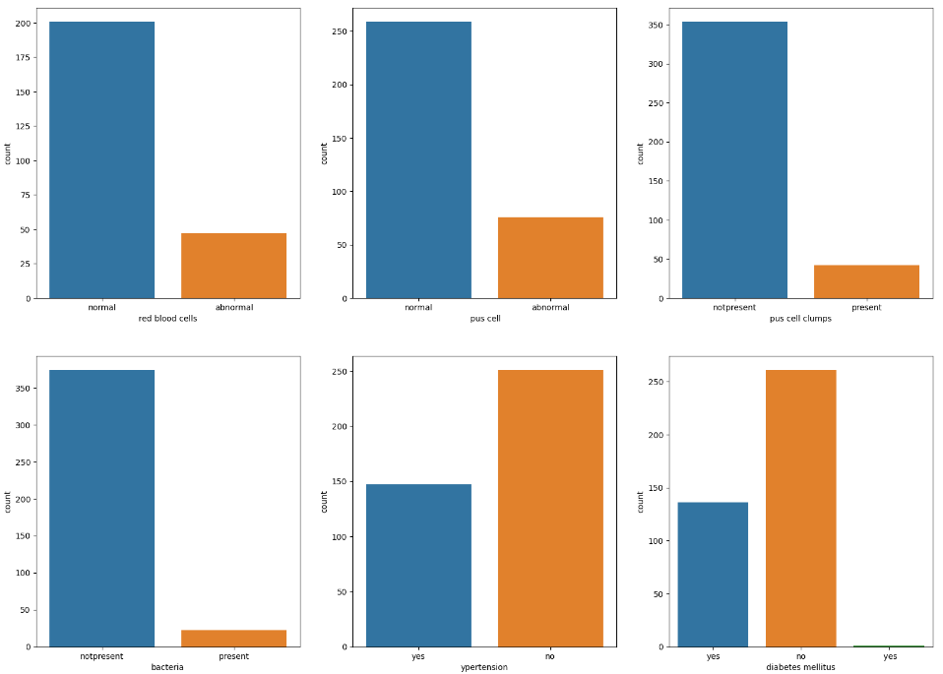
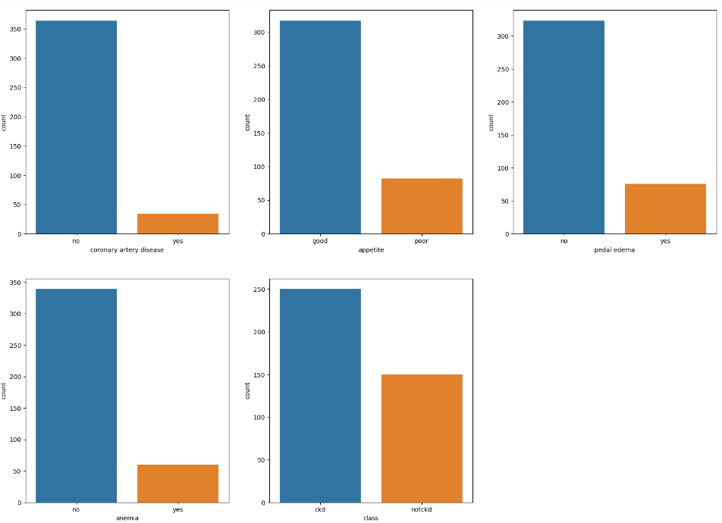
3. Checking Label Distribution of Categorical data.

Slide 9
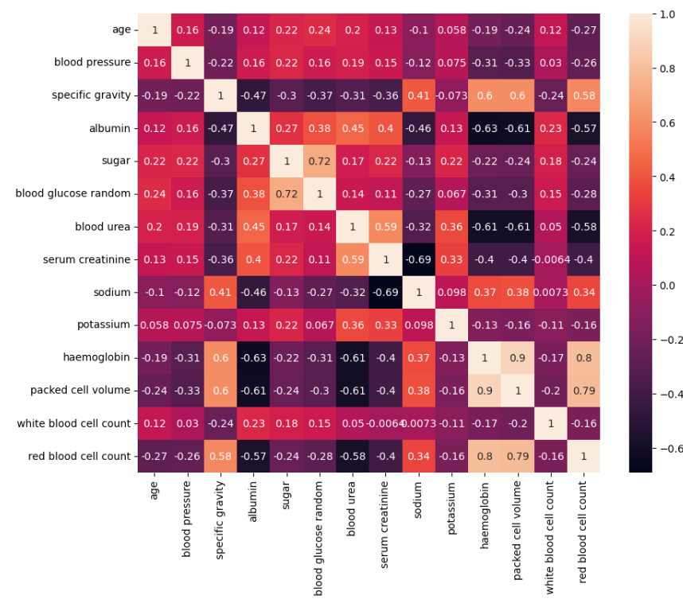
4. Check how Columns are Co-Related with each other & its impact on target feature

Slide 10
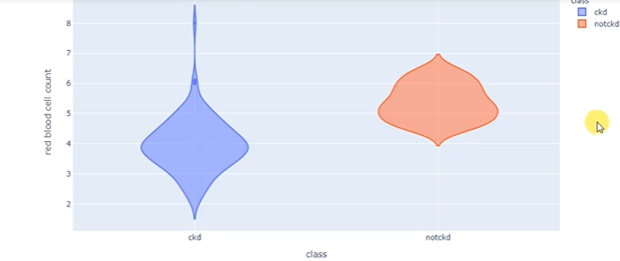
Impact on target feature

Slide 11
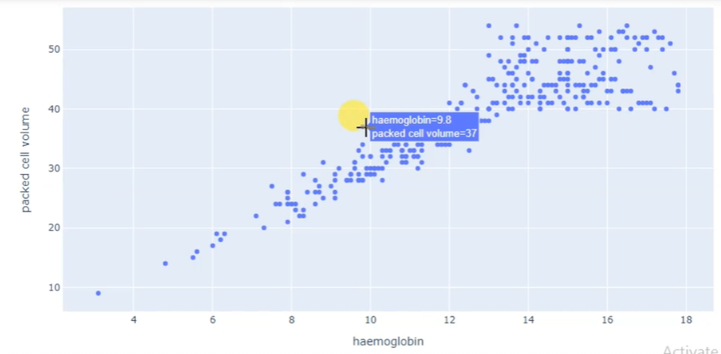
5. Find relationship between haemoglobin & packed cell volume.

Slide 12
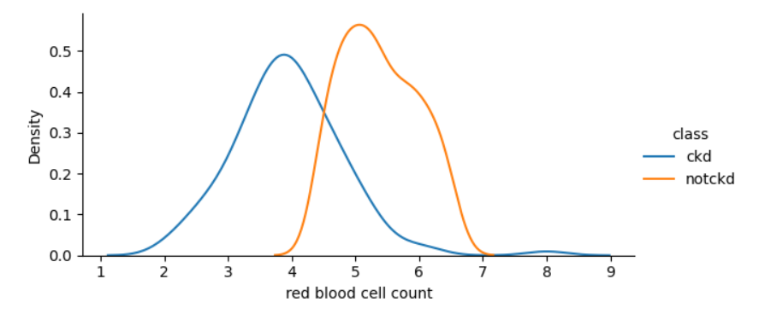
6. Analysing distribution of ‘red blood cell count’ Chronic as well as non-Chronic

Slide 13
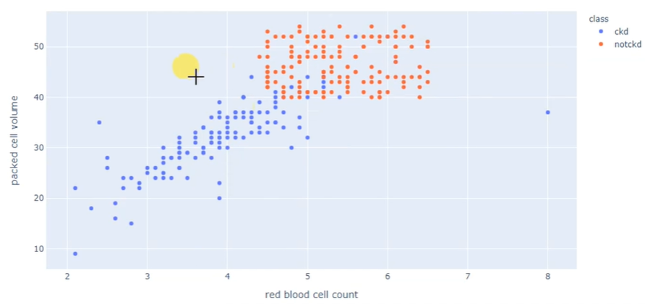
7. Performing Exploratory data Analysis on data
According to above graph we can say that if a person is having high haemoglobin level with increasing packed cell volume that person has got high chances of having chronic disease.

Slide 14
8. Perform data cleaning & deal with Missing Values.
Check for missing Values first
Fill data randomly in data set
9. Applying Feature encoding technique on data.
Identifying Categories and go for Label Encoding
10. Select best features of your model using suitable feature Importance techniques.
Import Chi2: to check the probability values that are less than 0.5
We get dependent and undependent feature
After that we will go for Kbest through which we will get Kbest feature depending upon its probability values
Then we will extract top 10 data on the basis of score
And now this 10 data will decide whether the person has CKD or not

Slide 15
11. Building Cross-Validation model & predict & Check Accuracy of the Model.
Splitting training data & testing data
Set Hyperparameter: Hyperparameters are the parameters which can be customised to get best accuracy.
By random search we will identify models by fitting X and Y
After that we will predict best model & the model which is achieved will be get after Cross Validation & Hyperparameter Optimization
12. And at last with the help of Confusion matrix we will get Accuracy.

Slide 16
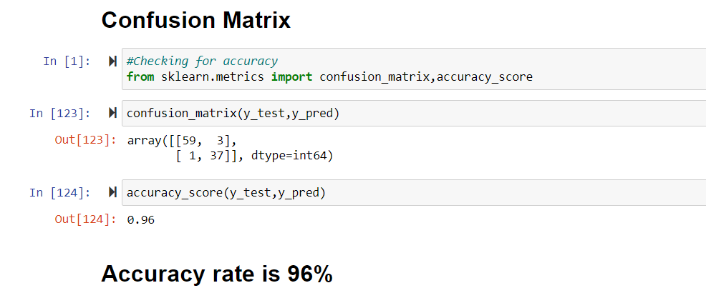
OUTPUT

Slide 17
CONCLUSION
In conclusion, the project aims to use machine learning to accurately detect chronic kidney disease by analyzing patient data. By developing a reliable and accurate predictive model, the project has the potential to contribute significantly to the early identification and intervention of the disease, improving patient outcomes.

Slide 18
REFERENCE
[1] https://www.ncbi.nlm.nih.gov/pmc/articles/PMC9874070/
[2] https://link.springer.com/article/10.1007/s44174-022-00027-y
[3]https://www.analyticsvidhya.com/blog/2022/01/predicting-chronic-kidney-disease-using-machine-learning/
[4] https://ieeexplore.ieee.org/document/9185249
[5] https://www.hindawi.com/journals/cmmm/2021/6141470/
[6] https://www.mdpi.com/2504-2289/6/3/98
[7]https://www.researchgate.net/publication/329395701_Prediction_of_Chronic_Kidney_Disease_Using_Machine_Learning_Algorithm

Slide 19
THANK YOU!!!

